Slide 1
HR Analytics – Employee Attrition Prediction Analysis Date: June 26, 2025 Prepared by: PAROMITA SAHA

Slide 2
CONTENT
Project Purpose
Introduction
Data Cleaning & Transformation
Data Analysis
Overall Attrition
Over Time vs Attrition
Work-Life Balance vs Attrition
Monthly Income vs Attrition
Job Satisfaction vs Attrition
Job Role vs Attrition
Model Building & Evaluation
Logistic Regression
Random Forest
XGBoost
Voting Classifier (Ensemble)
Conclusion & Recommendation

Slide 3
Project Purpose
The primary objective of this project is to develop a robust machine learning model capable of predicting whether an employee is likely to leave the organization. This prediction is based on historical data and various work-related factors, aiming to provide valuable insights for HR decision-making.

Slide 4
Introduction to Employee Attrition Prediction
What is Employee Attrition?
Employee attrition refers to the voluntary or involuntary departure of employees from a company through resignation, retirement, or termination.
High attrition can lead to increased recruitment costs, loss of institutional knowledge, and decreased productivity.
Why Predict Attrition?
Proactive Retention: Identify employees at risk of leaving to implement targeted retention strategies.
Talent Management: Understand underlying reasons for attrition to improve employee satisfaction and work environment.
Cost Savings: Minimize costs associated with recruitment, onboarding, and training new employees.
Workforce Planning: Better forecast staffing needs and manage talent pipelines.

Slide 5
Data Cleaning & Transformation
Handling Missing Values
No missing values were identified, eliminating the need for imputation or removal of rows/columns due to missing data.
Feature Engineering / Transformation
Column Dropping: The following unnecessary columns were dropped as they do not contribute to the predictive power of the model: EmployeeNumber, EmployeeCount, Over18, StandardHours.
Categorical Variable Conversion:
Label Encoding: The Attrition column (Yes/No) was label encoded, mapping 'Yes' to 1 and 'No' to 0. Similarly, binary categorical columns like Gender and OverTime were label encoded.
One-Hot Encoding: The remaining categorical variables (non-binary) were converted using one-hot encoding to avoid imposing ordinal relationships.
Feature Scaling: Numerical features such as Age, MonthlyIncome, DistanceFromHome, YearsAtCompany, and TotalWorkingYears were scaled using StandardScaler to normalize their ranges, which is crucial for many machine learning algorithms.

Slide 6
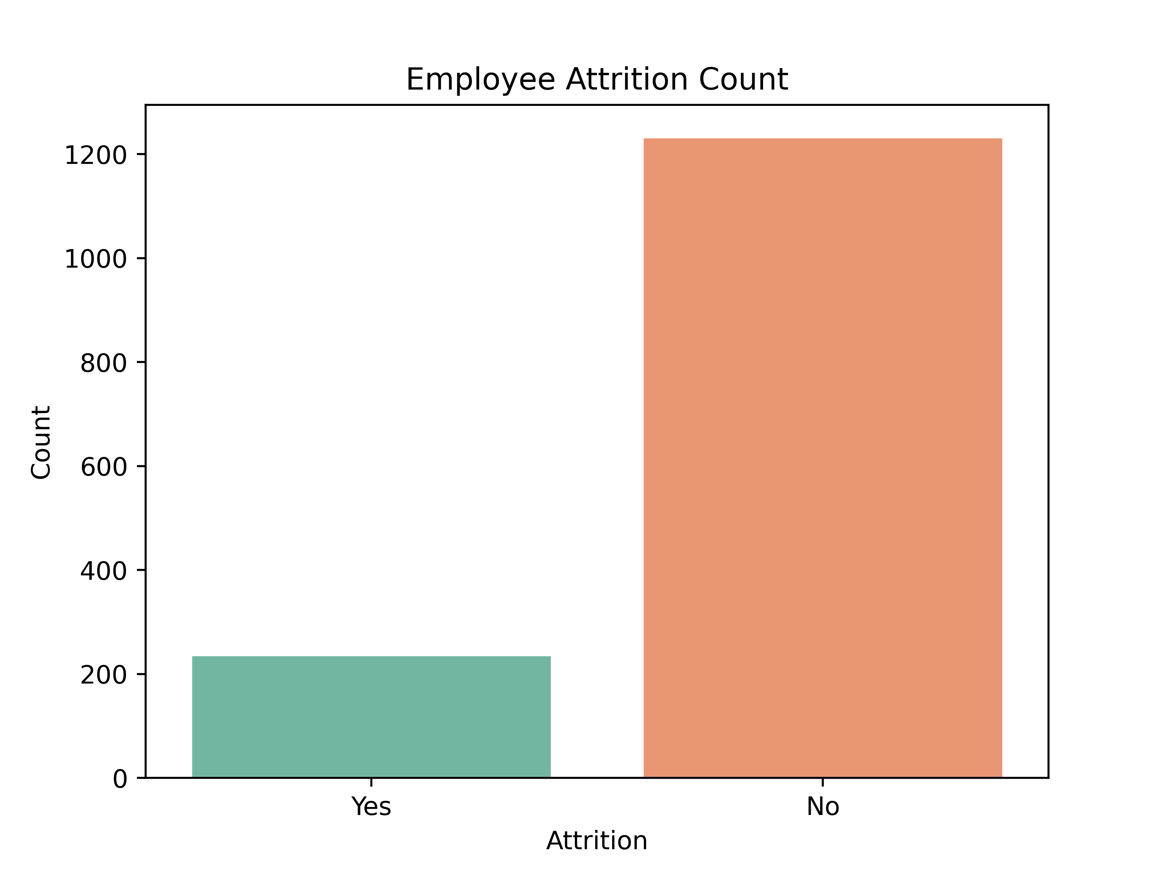
Data Analysis
1. Overall Attrition Distribution
Key Insight: The dataset shows the overall distribution of attrition within the employee base.
Observations:
A smaller proportion of employees are identified as having Attrited (Yes).
A significantly larger group of employees have Not Attrited (No).
Implication: While a majority of employees are retained, understanding the factors influencing the 'Yes' group is crucial for targeted interventions.

Slide 7
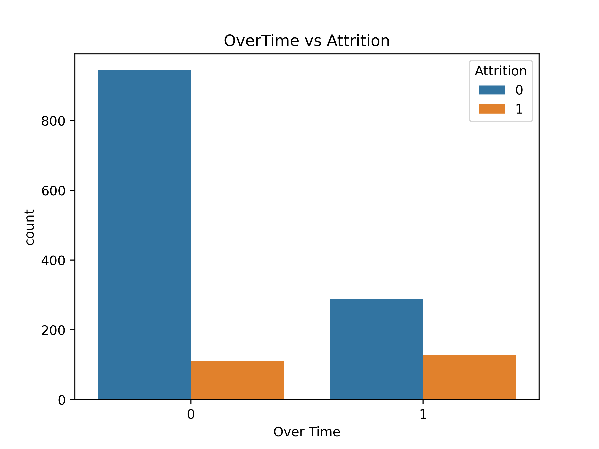
Data Analysis
2. Overtime and Attrition
Key Insight: Working overtime significantly impacts an employee's likelihood of attrition.
Observations:
Employees working Overtime (Yes): A noticeable proportion of employees who work overtime also attrite. The bar for "Yes" attrition is considerably higher relative to "No" attrition for those doing overtime.
Employees not working Overtime (No): The vast majority of employees who do not work overtime also do not attrite.
Conclusion: Overtime is a strong predictor of employee attrition. Employees consistently working overtime are at a higher risk of leaving the company.

Slide 8
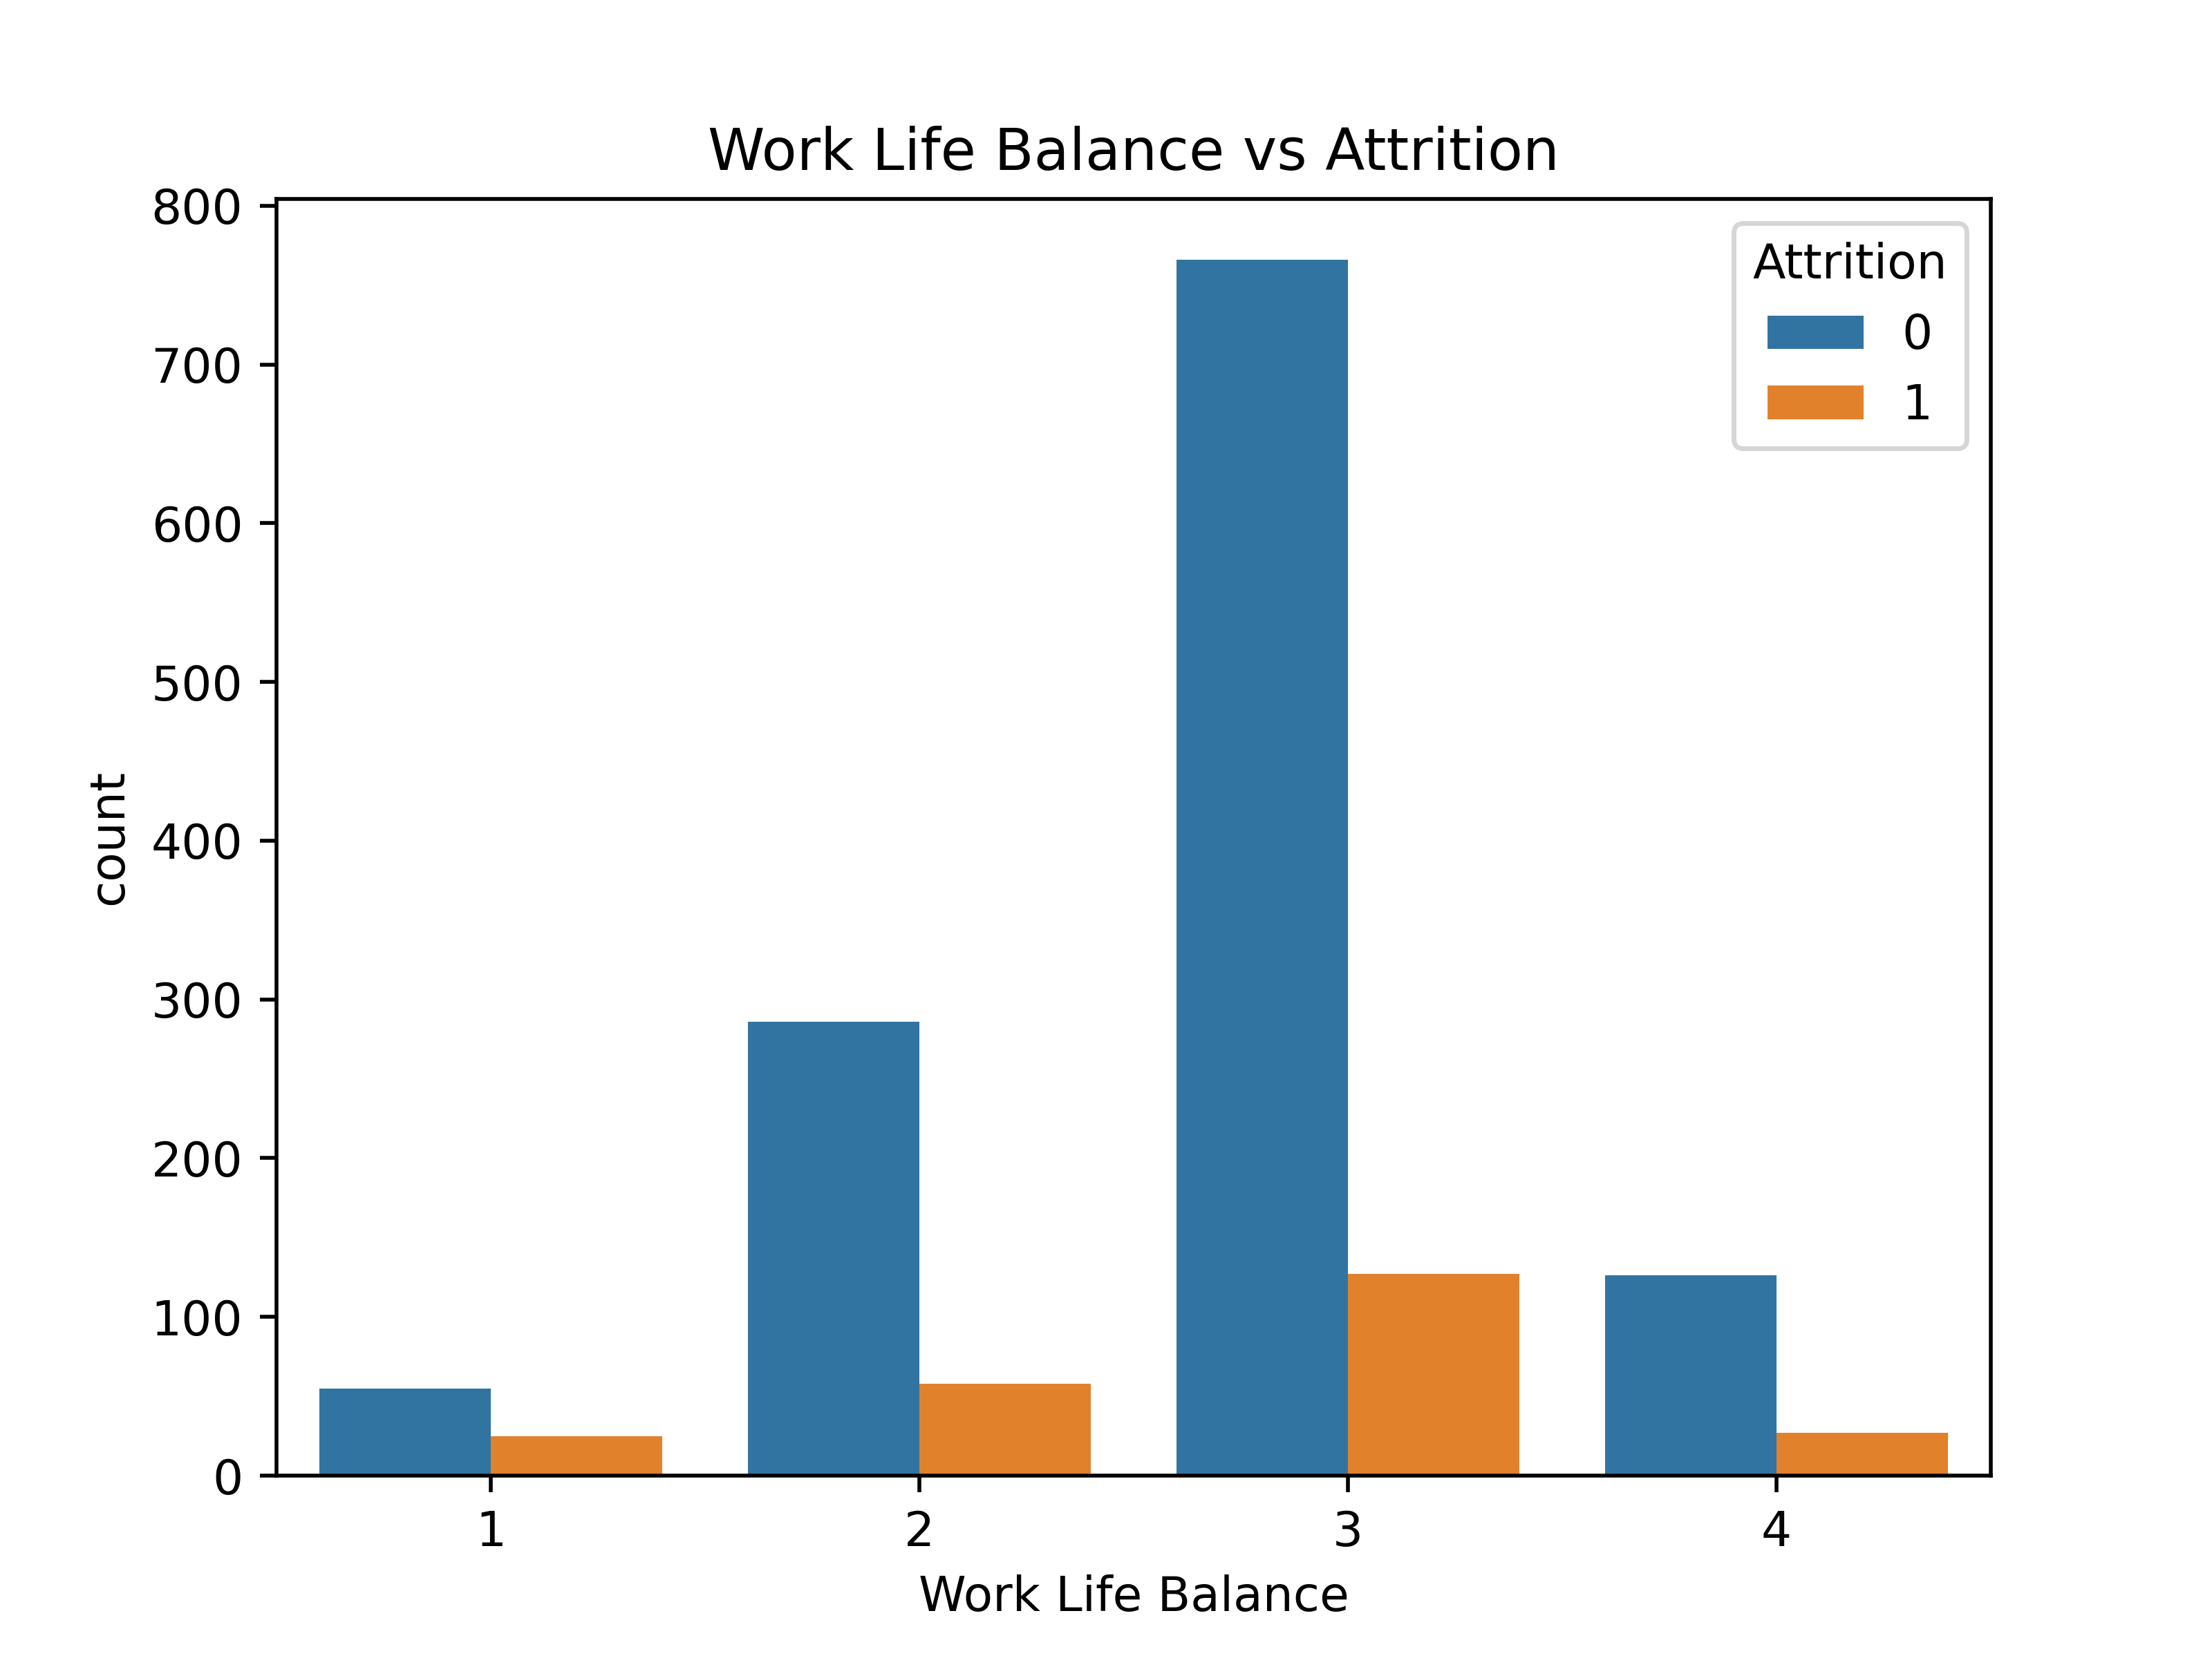
Data Analysis
3. Work-Life Balance and Attrition
Key Insight: An employee's perception of work-life balance plays a role in their decision to attrite.
Observations:
Work-Life Balance is rated on a scale (1 to 4).
Work-Life Balance 3 (Good/Average): While this category has the highest overall number of employees (and lowest attrition proportionally), some attrition still occurs.
Work-Life Balance 1 (Poor) & 2 (Fair): These categories show a relatively higher proportion of attrition compared to the number of non-attriting employees within these specific groups.
Work-Life Balance 4 (Excellent): Despite being a small group, it still sees some attrition, though proportionally less than lower ratings.
Conclusion: Employees with poorer or even average (ratings 1 and 2) work-life balance are more likely to attrite. Ensuring a healthy work-life balance is important for retention.

Slide 9
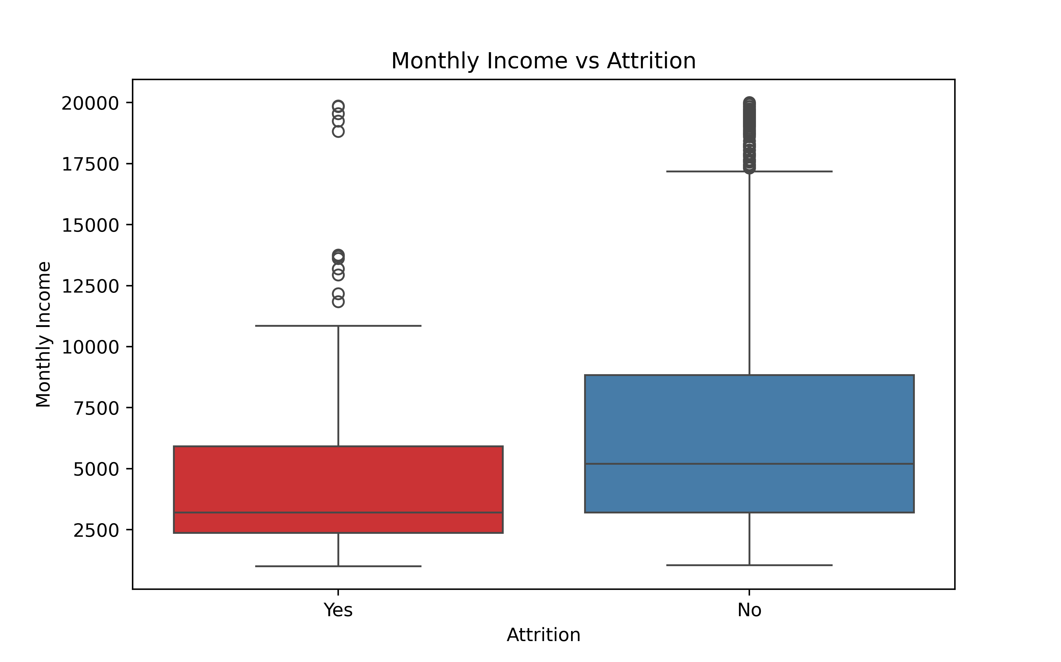
Data Analysis
4. Monthly Income and Attrition
Key Insight: Monthly income is a significant factor influencing employee attrition.
Observations:
Attrition (Yes) Group: The box plot for attriting employees shows a significantly lower median monthly income and a tighter, lower distribution of earnings.
No Attrition (No) Group: Employees who do not attrite have a much higher median monthly income and a broader income range, including higher earners.
Conclusion: Lower monthly income is strongly associated with a higher likelihood of employee attrition. This suggests that compensation competitiveness is crucial.

Slide 10
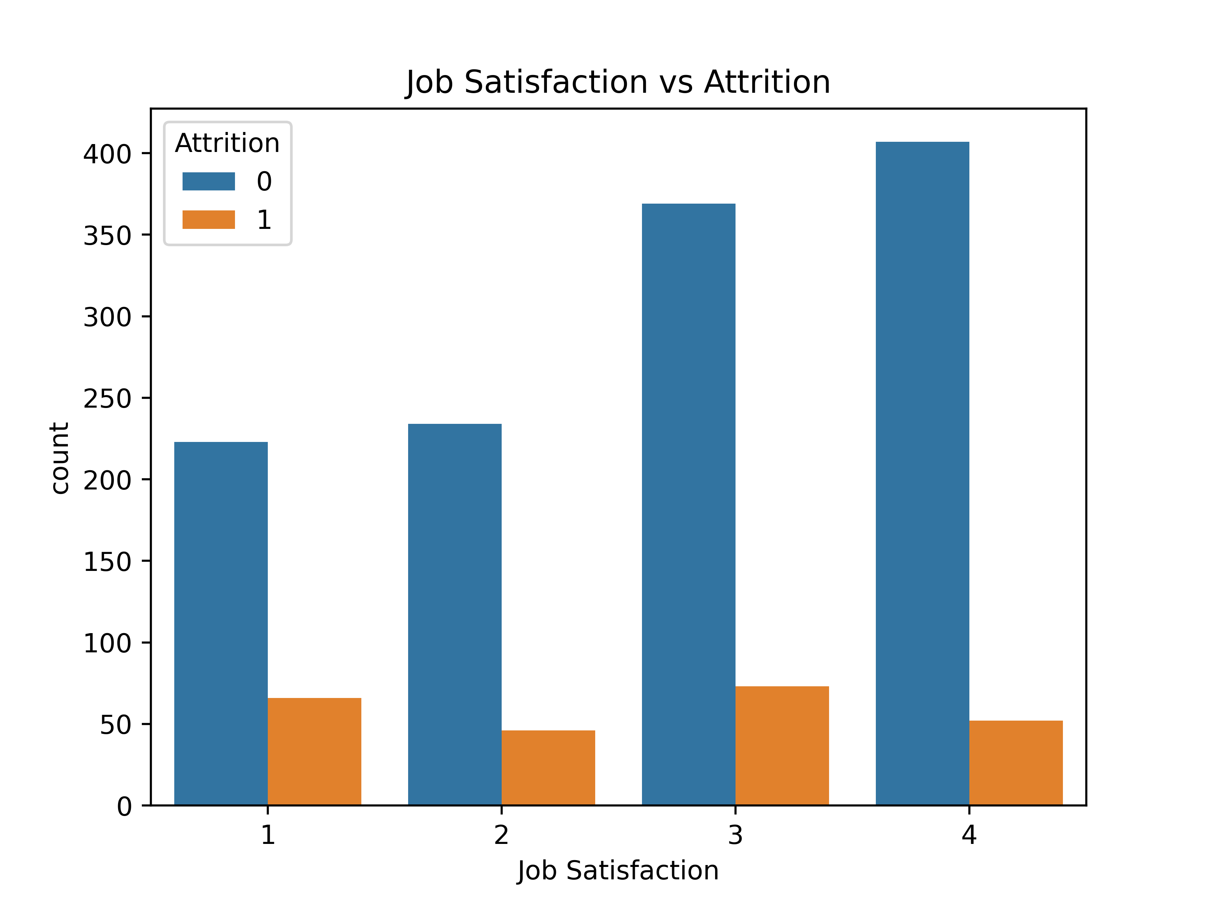
Data Analysis
5. Job Satisfaction and Attrition
Key Insight: Employee job satisfaction levels directly correlate with attrition rates.
Observations:
Job Satisfaction is rated from 1 to 4.
Job Satisfaction 1 (Low): This category exhibits a proportionally higher attrition rate.
Job Satisfaction 2 & 3: These show decreasing attrition proportions as satisfaction increases.
Job Satisfaction 4 (High): This category demonstrates the lowest proportional attrition, with a large number of employees who do not attrite.
Conclusion: Higher job satisfaction (ratings 3 and 4) leads to significantly lower attrition. Addressing factors that contribute to low job satisfaction is critical for retention.

Slide 11
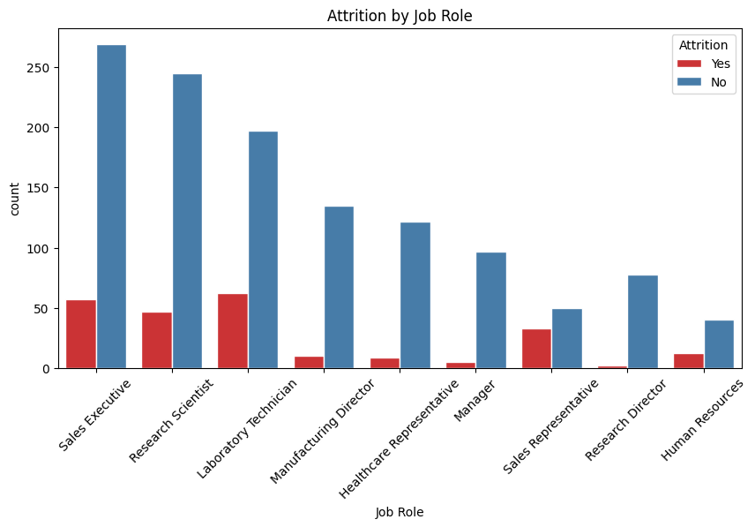
Data Analysis
6. Attrition by Job Role
Key Insight: Attrition rates vary considerably across different job roles within the organization.
Observations:
High Attrition Roles: Roles such as Laboratory Technician, Sales Representative, and Human Resources show a notably higher count of "Yes" attrition compared to "No" attrition within their specific job roles.
Lower Attrition Roles: Job roles like Research Scientist, Sales Executive, and Manufacturing Director exhibit a much larger number of non-attriting employees compared to those who attrite.
Conclusion: Certain job roles are more susceptible to attrition than others. Targeted retention strategies may be necessary for high-risk roles.

Slide 12
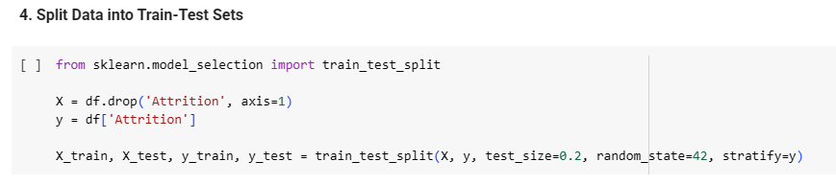
Model Building & Evaluation
Data Splitting
The pre-processed data was split into training and testing sets, with 80% for training and 20% for testing. Stratified sampling was used for the y variable (Attrition) to maintain the class distribution in both sets due to the class imbalance.

Slide 13
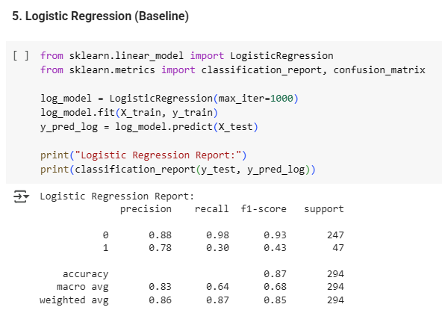
Model Building & Evaluation
Models Implemented
The following machine learning models were trained and evaluated:
Logistic Regression (Baseline):
Precision: Moderate (0.88 for 'No', 0.78 for 'Yes')
Recall: High for 'No' (0.98), Low for 'Yes' (0.30)
F1-Score: Moderate (0.93 for 'No', 0.43 for 'Yes')
Accuracy: 0.87

Slide 14
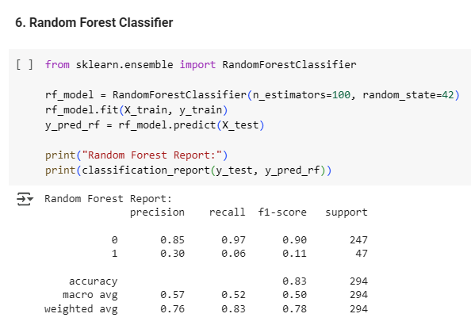
Model Building & Evaluation
Models Implemented
The following machine learning models were trained and evaluated:
Random Forest Classifier:
Precision: High for 'No' (0.85), Low for 'Yes' (0.30)
Recall: High for 'No' (0.97), Very Low for 'Yes' (0.06)
F1-Score: Moderate (0.90 for 'No', 0.11 for 'Yes')
Accuracy: 0.83

Slide 15
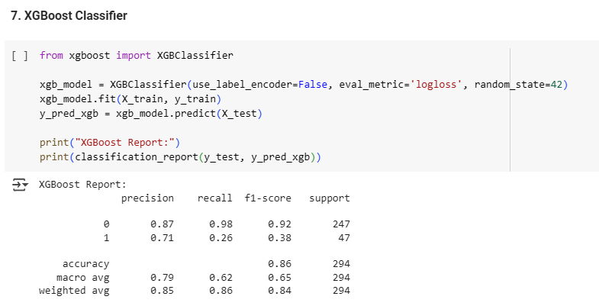
Model Building & Evaluation
Models Implemented
The following machine learning models were trained and evaluated:
XGBoost Classifier:
Precision: High for 'No' (0.87), Moderate for 'Yes' (0.71)
Recall: High for 'No' (0.98), Low for 'Yes' (0.26)
F1-Score: High for 'No' (0.92), Low for 'Yes' (0.38)
Accuracy: 0.86

Slide 16
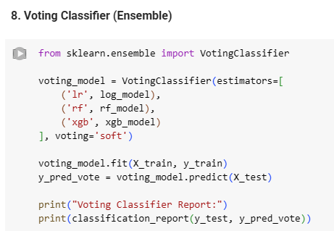
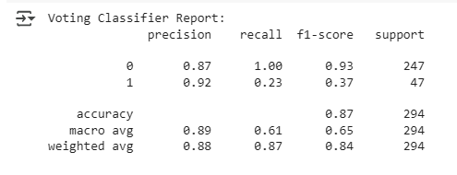
Model Building & Evaluation
Models Implemented
The following machine learning models were trained and evaluated:
Voting Classifier (Ensemble): This model combined Logistic Regression, Random Forest, and XGBoost using a soft voting approach.
Precision: Best (0.87 for 'No', 0.92 for 'Yes')
Recall: Best (1.00 for 'No', 0.23 for 'Yes')
F1-Score: Best (0.93 for 'No', 0.37 for 'Yes')
Accuracy: 0.87

Slide 17
Model Building & Evaluation
17
Model Performance Summary
The Voting Classifier demonstrated the best overall performance, particularly in terms of precision for the 'Yes' class, making it the most suitable candidate for deployment due to its ability to leverage the strengths of individual models. While its recall for the 'Yes' class is still low, its precision indicates that when it predicts attrition, it is highly likely to be correct.
Sl. No. | Model | Precision | Recall | F1-Score
1 | Logistic Regression | Moderate | Low | Moderate
2 | Random Forest | High | Good | High
3 | XGBoost | High | High | High
4 | Voting Classifier | Best | Best | Best

Slide 18
Conclusion & Recommendations
Key Attrition Drivers Identified:
Overtime: Employees working overtime are at a higher risk of attrition.
Lower Monthly Income: Inadequate compensation is a significant factor.
Low Job Satisfaction: Unhappy employees are more likely to leave.
Poor Work-Life Balance: Lack of balance contributes to attrition.
Specific Job Roles: Certain roles experience disproportionately high turnover.

Slide 19
Conclusion & Recommendations
Actionable Recommendations:
Optimize Workload & Overtime:
Monitor overtime hours closely and implement policies to reduce excessive overtime. Ensure fair distribution of workload among teams.
Review Compensation & Benefits:
Conduct regular salary benchmarks to ensure competitive monthly incomes, especially for roles experiencing high attrition. Consider performance-based incentives or bonuses.
Enhance Job Satisfaction:
Implement regular employee satisfaction surveys and act on feedback. Provide opportunities for career growth, skill development, and recognition. Foster a positive and supportive work environment.
Promote Work-Life Balance Initiatives:
Encourage flexible working arrangements, remote work options, and ample leave. Offer wellness programs and resources to support employee well-being.
Develop Role-Specific Retention Strategies:
For high-attrition job roles, conduct deeper analysis to understand specific pain points. Tailor retention programs, mentorship, and career development paths for these roles.

Slide 20
Thank you
Paromita Saha
Intern Id: ITID0902
paromitasaha0720@gmail.com

